Slide 1
Prepositions of Place

Slide 2
The woman is on the rug.

Slide 3
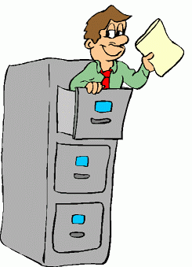
The man is in the drawers.

Slide 4
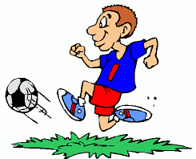
The ball is in front of the footballer.

Slide 5
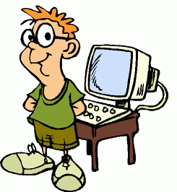
He is in front of the computer.

Slide 6
The cat is sleeping on the pillow.

Slide 7
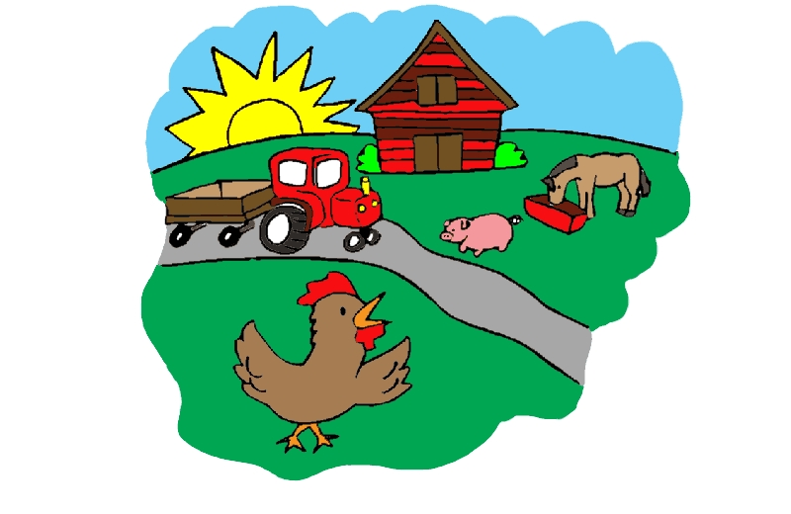
The sun is rising behind the hill.

Slide 8
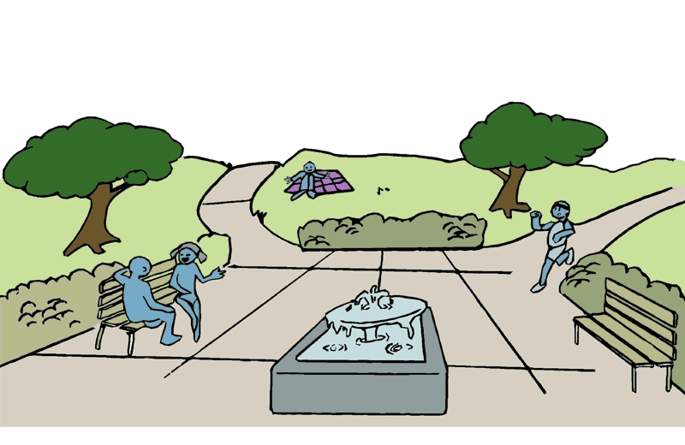
The girl is sitting next to the boy. bbbbboyman.

Slide 9
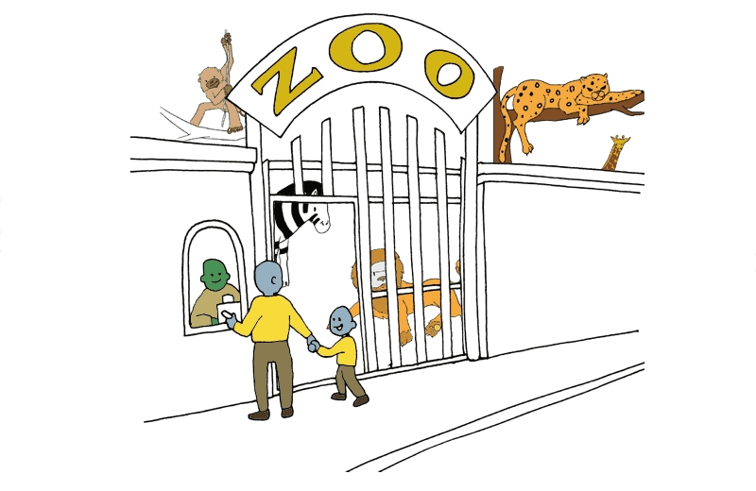
There are animals in the zoo.

Slide 10
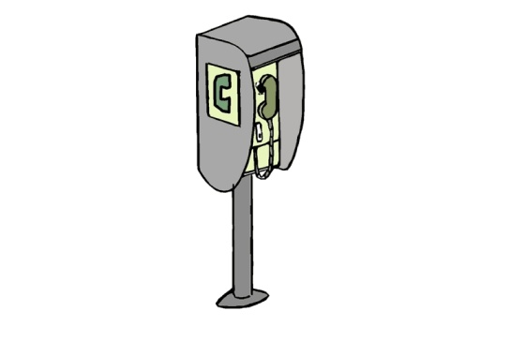
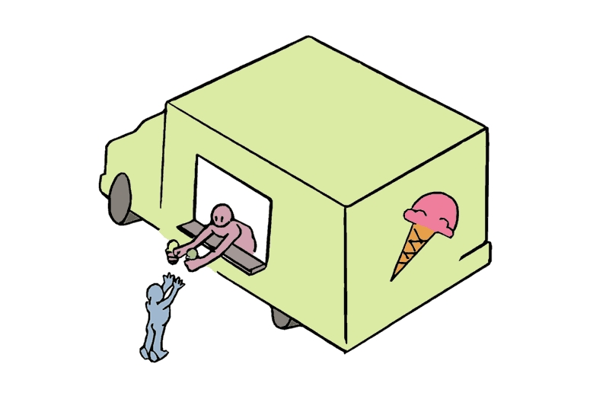
The phone box is near the ice cream van.

Slide 11
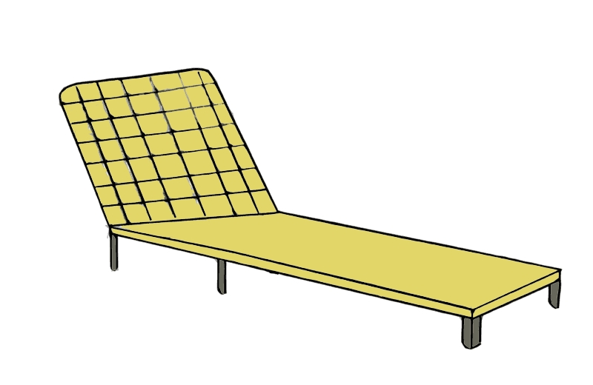
The red ball is under the beach chair.

Slide 12
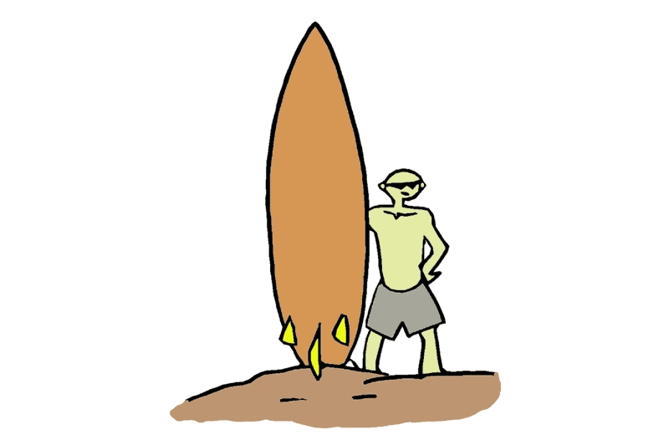
The surfer is next to the board.

Slide 13
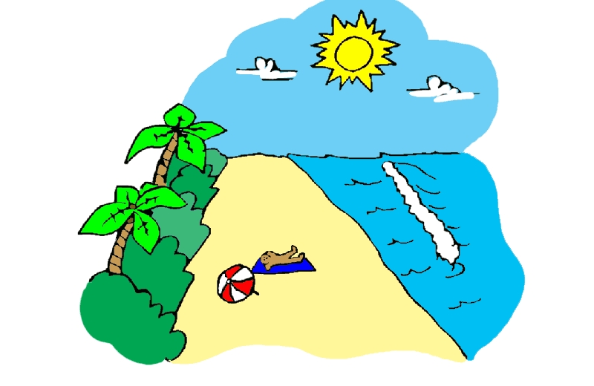
He is lying on the beach.

Slide 14
There are two trees behind the man.

Slide 15
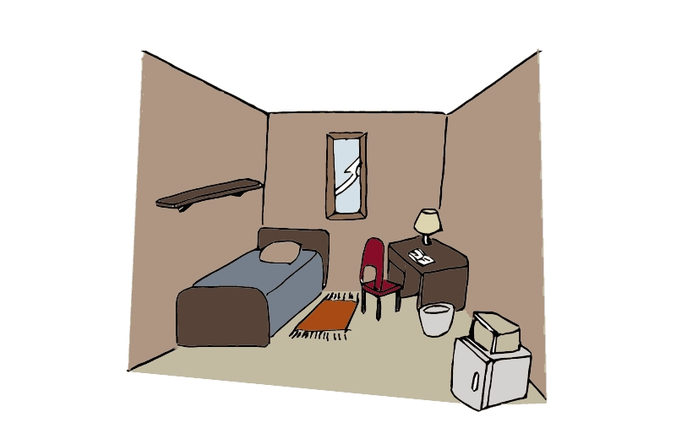
There is a lamp on the desk.

Slide 16
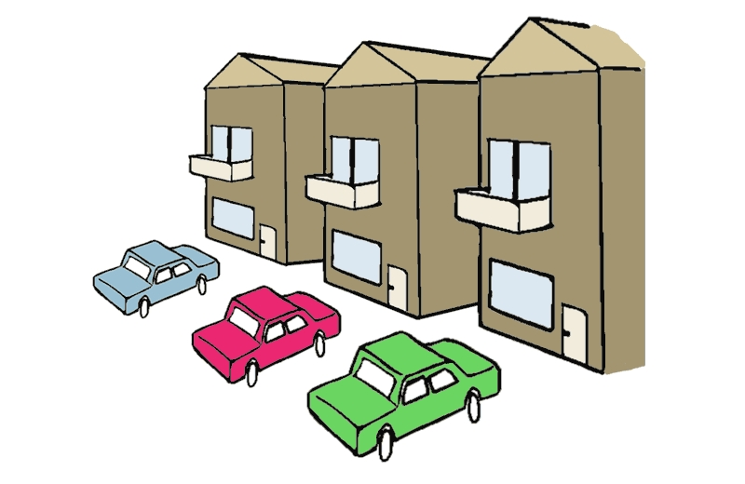
The red car is between the blue car and the green car.

Slide 17
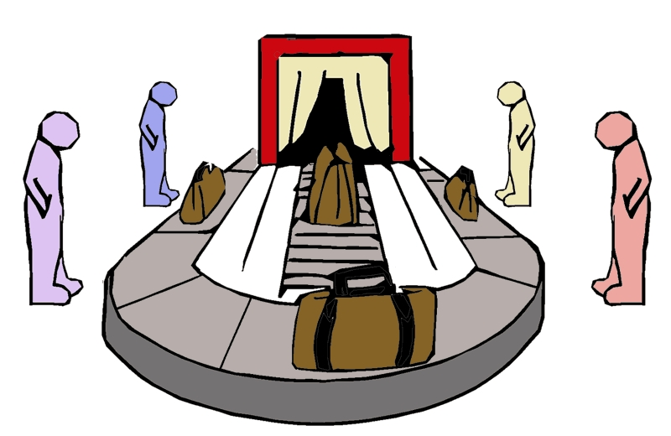
The people are around the baggage carousel.

Slide 18
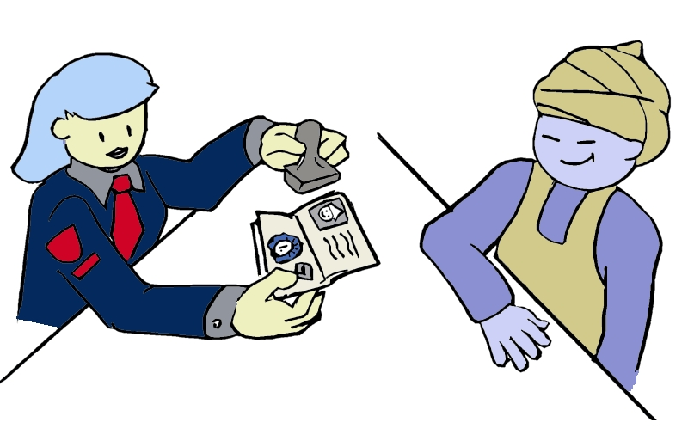
The tourist is opposite the officer.

Slide 19
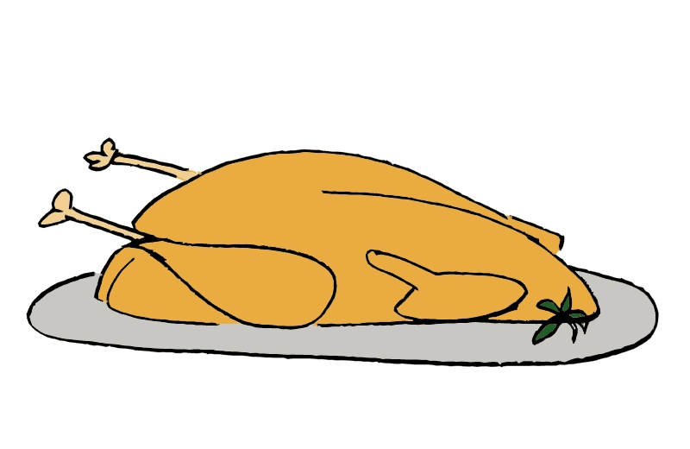
There is some turkey on the plate.

Slide 20
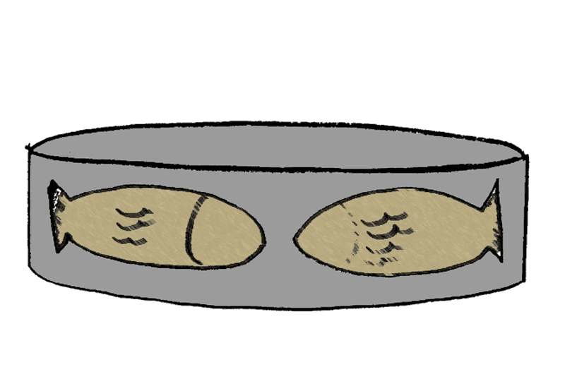
There is fish in the tin.

Slide 21
The dog is under the tree

Slide 22
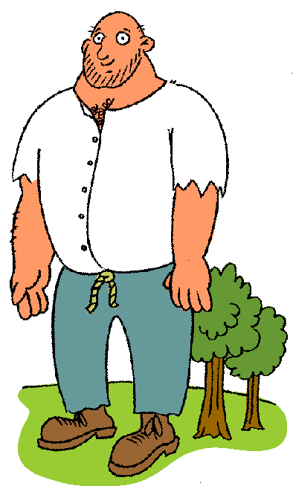
There are two trees behind the giant.

Slide 23
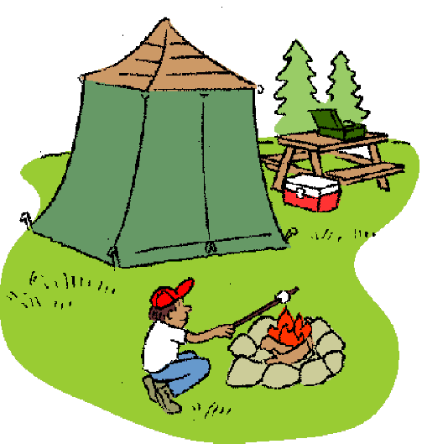
There is a fire and a seat near the tent.

Slide 24
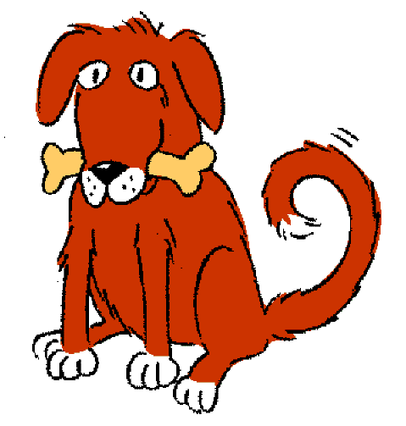
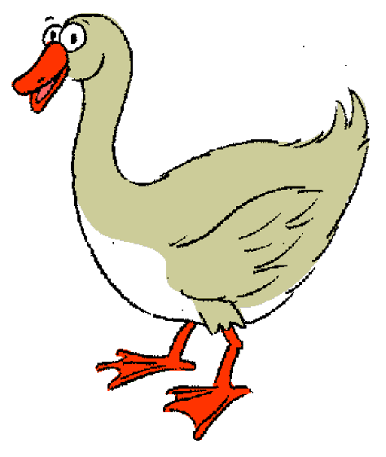
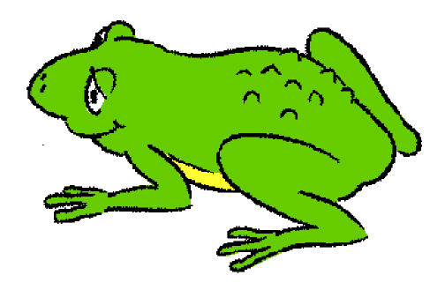
The frog is between the dog and the goose.

Slide 25
There are stones around the fire.

Slide 26
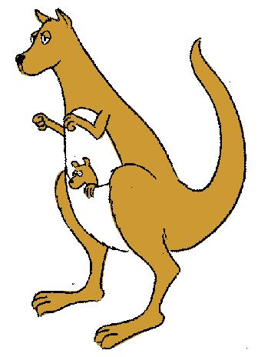
The kangaroo has got a baby in its pouch.

Slide 27
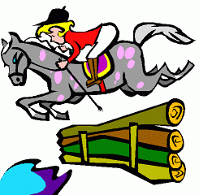
The horse is jumping over the fence.

Slide 28
A helicopter is flying over the hill.

Slide 29
There is some cereal in the bowl.

Slide 30
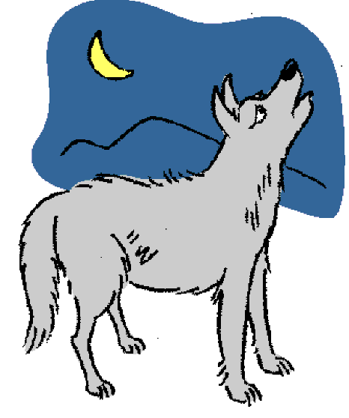
You can see the moon in the sky.

Slide 31
He is putting the paper in the paper basket.

Slide 32
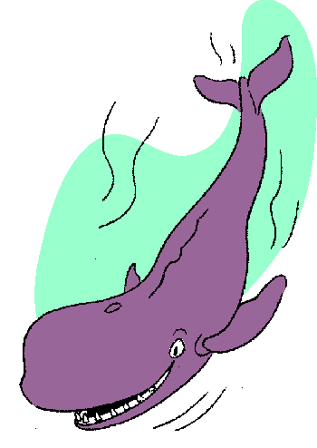
The whale is swimming in the sea.

Slide 33
The cat is behind the trash can.

